Slide 1
Talent Management Case Study
Nnenna Okpara

Slide 2
Analysis Overview
Attrition overview
Job specific trends
Predicting Attrition
Monthly Income prediction

Slide 3
Overview of Attrition
Datasets contains information about 870 employees with 35 variables
730 No Attrition vs 140 Attrition
Factors that lead to Attrition:
Overtime
Monthly Income
Years in Current Role
Job Role
Notes:
About 16% left the company
730 people stayed in the company and 140 was left the company

Slide 4
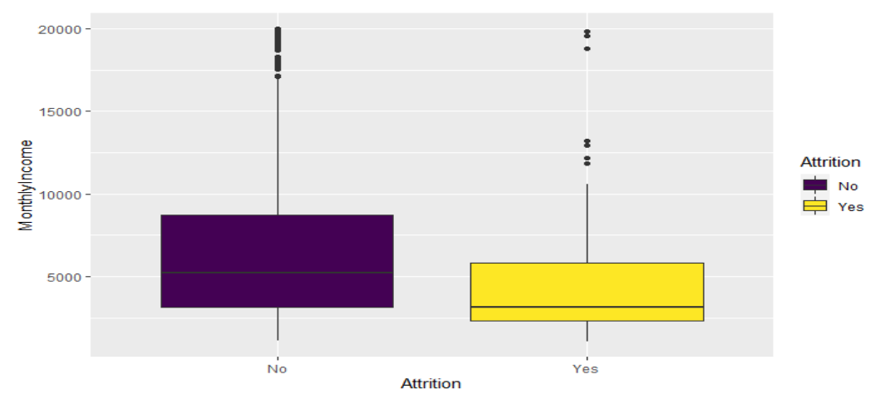
Monthly Income vs Attrition
Attrition is common with employees that make <$5000
p-value = 4.422e-06 (from t-test)
Notes:
Significant difference from the P-value

Slide 5
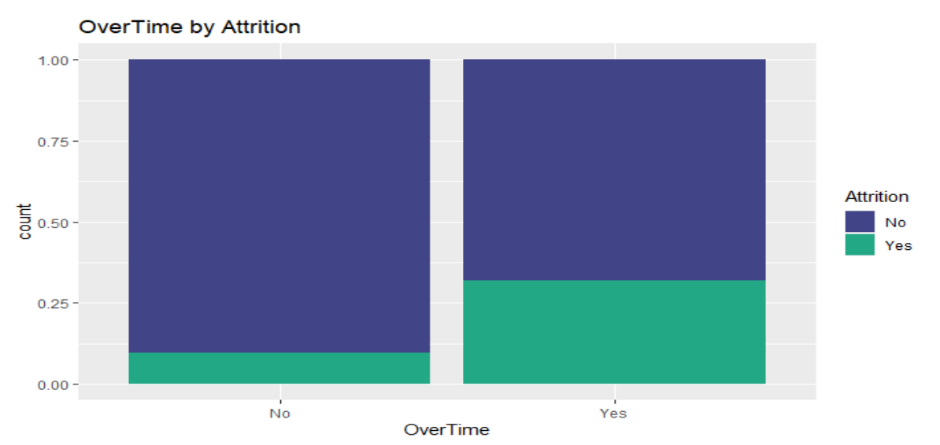
Overtime vs Attrition
Attrition is common in employees that work overtime
P-value = 2.333e-15 (Chi-squared test)
About 45% of the employees that left worked overtime
About 23% of the retained employees worked overtime

Slide 6
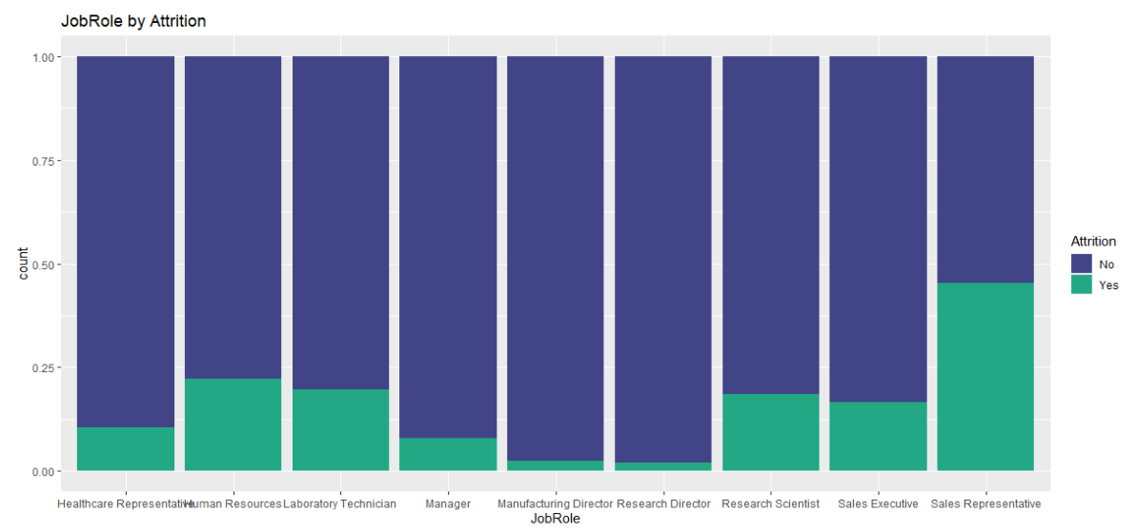
Attrition vs Job Role
Sales Representative have the highest attrition rate (~46%)
Human Resources (~23%)

Slide 7
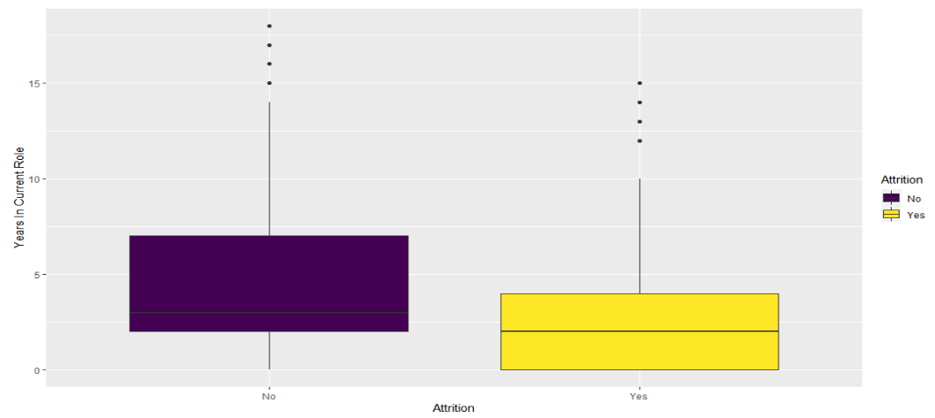
Years in Current Role vs Attrition
Attrition is common in employees with <5years
P-value = 3.665e-06 (from t.test)

Slide 8
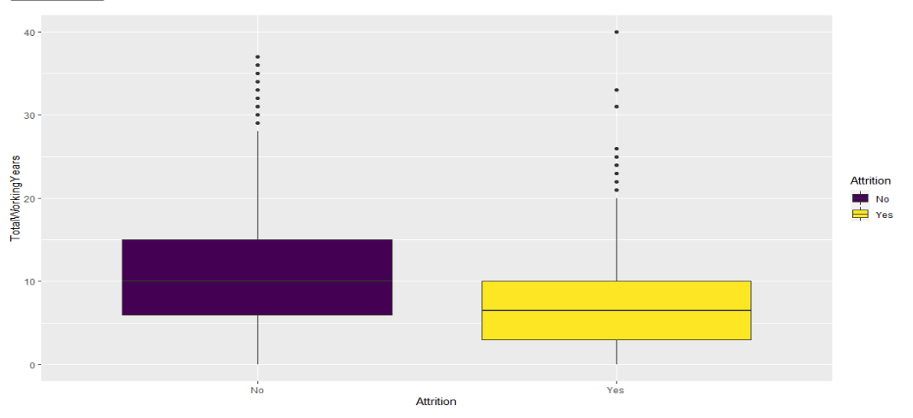
Total working years vs Attrition
Attrition is common in employees with <5years

Slide 9
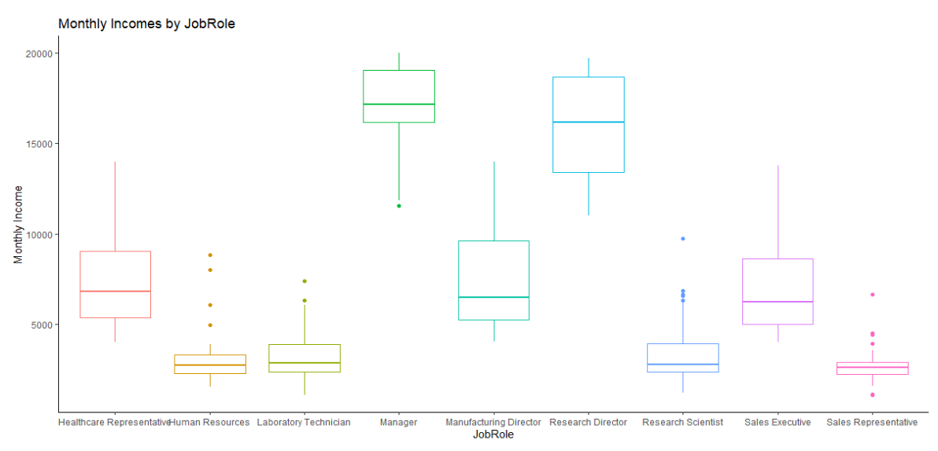
Monthly Income and Job Role
Relationship between Monthly Income and Job Role
Possible variables to use to predict Attrition

Slide 10
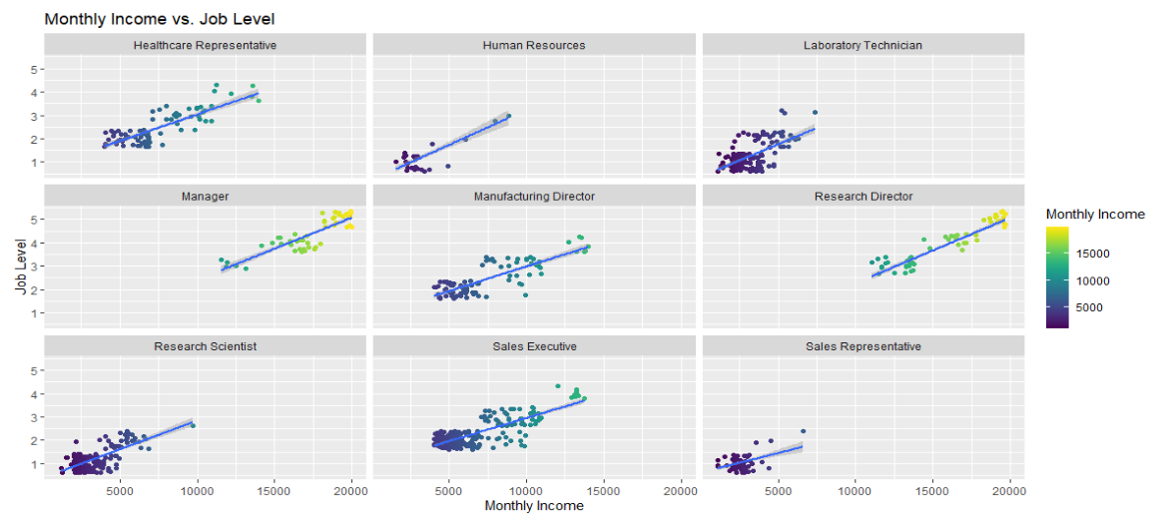
Monthly Income and Job level
Relationship between Monthly Income and Job level
Possible variables to add to the model
Monthly income is based on the job level

Slide 11
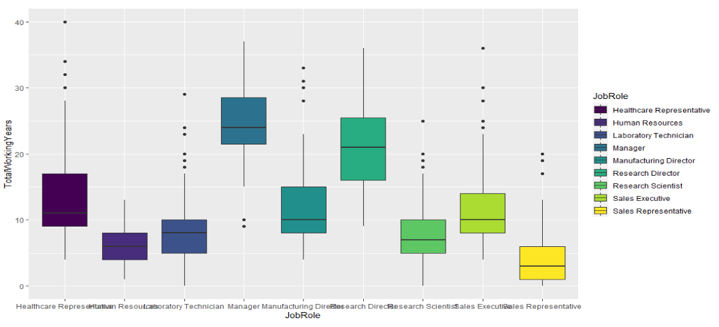
Job Roles Trend
Sales Representative
Lowest monthly income
Highest Attrition rate
Have the lowest average by category
Lowest total working years (< 5 years)
Job involvement is ~2.6

Slide 12
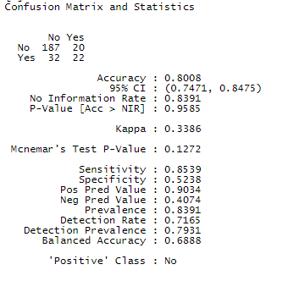
Attrition Prediction Model
Naive Model for Prediction
Sensitivity : 85%
Specificity: 52%

Slide 13
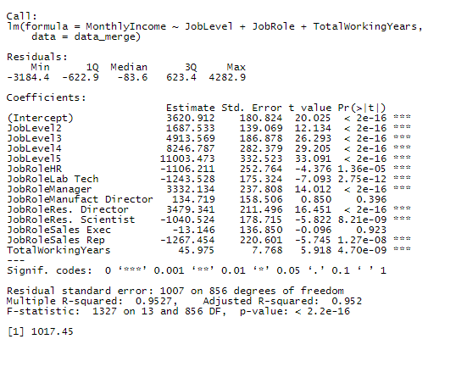
Monthly Income Prediction
Linear Regression for prediction
RMSE: 1017 (<3000)
Variables used for prediction:
Job Role
Job level
TotalWorkingYears

Slide 14
Takeaways
Monthly Income is the most significant variable used to predict Attrition.
Overtime, Years in current Role, Monthly Income are keys factors that lead to Attrition.
Sales Representatives have the highest Attrition Rate.
Job Role, Total working years and Job level are important variables used to predict monthly income.
Directors have the lowest Attrition Rate.

